Slide 1
Heuristic Evaluation Plan
Group G2-04

Slide 2
Team
Katharina Schmied
Marco Defant
Rolando Kristian Unger
Vanessa Komar

Slide 3
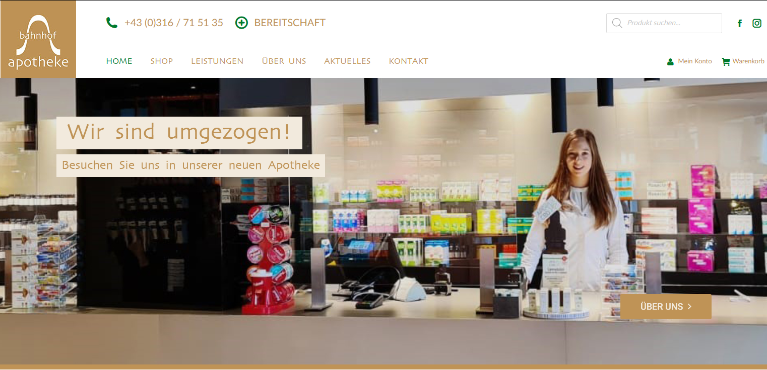
Introduction
Evaluation of bahnhof-apo.at
Website of the pharmacy at Graz main station
Overview of services can be found on the website

Slide 4
Methodology
Analyse website from user perspective
„Andrews General Usability Heuristics“
Heuristic evaluation:
Individual reviews of website
Evaluators discuss findings in a group
Results in Heuristic Report

Slide 5
User Profiles
Potential users:
Living balanced and healthy lifestyles
Picking up prescriptions
In person
Online/delivery
Seeking alternative/natural treatments

Slide 6
Devices
2 mobile devices (iOS)
2 laptops (Windows, Linux)
2 different browsers

Slide 7
Thank you for your attention!

